Slide 1
Air Travel: Pre-Pandemic vs. Post-Pandemic
Team #6 - Brian Monter and Mitchell Breeden
Dr. Huajun Zhang
George Mason University
AIT 580: Analytics: Big Data to Information

Slide 2


Introduction
In March 2020 the world as we knew it came to a halt due to a virus that was slowly spreading across the globe, called Covid-19. As you can imagine, every bit of life as we knew it was impacted in some way or another. Our data analytics project will take a look at and analyze the impact of Covid-19 on air travel. We will compare metrics before the pandemic and during the pandemic.

Slide 3

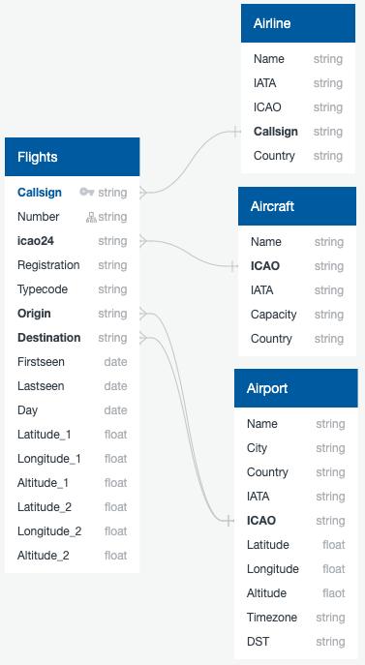

System Process
- 4 Data Sources
- Joined on unique columns with pandas
- Split result into cargo data frame and passenger flights data frame for analysis

Slide 4
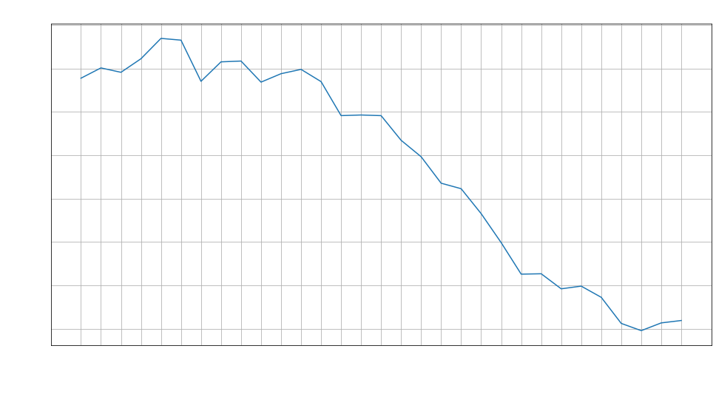
Data Visualization
- The total number of flights throughout March 2020

Slide 5
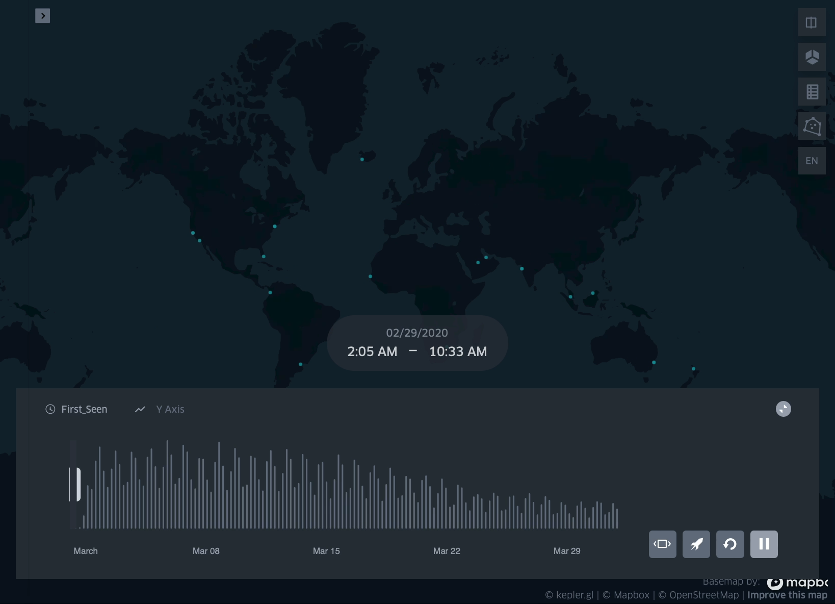
Data Visualization
- A map of all flights where they were first seen at different points during March 2020, illustrating the number of flights taking place on a given day

Slide 6
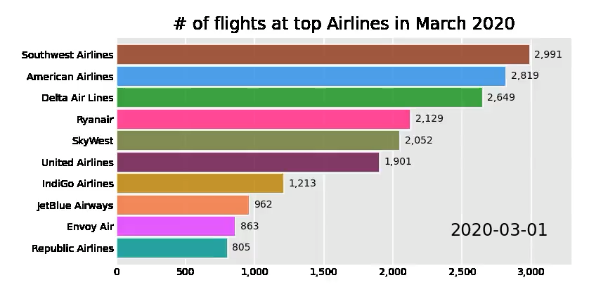
Data Visualization
- The total number of flights at the top 10 airlines around the world in March 2020.

Slide 7
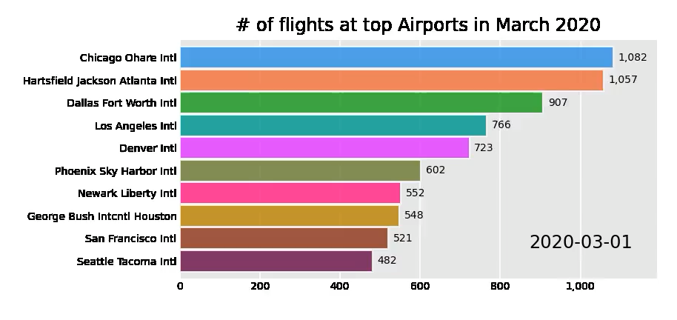
Data Visualization
- The total number of flights at the top 10 airports around the world in March 2020.

Slide 8
Descriptive Analytics
Average daily # of passenger flights Average daily # of cargo flights
Before March 15, 2020: 88,899.67 Before March 15, 2020: 1,214.93
After March 15, 2020: 48,762.88 After March 15, 2020: 1,264.5
Change: -45.15% Change: 4.08%
Average daily # of passengers
Before March 15, 2020: 6,083,030.93
After March 15, 2020: 3,141,443.12
Change: -48.36%

Slide 9

Inferential Analytics
- Industry as a whole: - 45.15%
- Only showing US airlines with > 100 flights
- Sorted by difference and percent

Slide 10
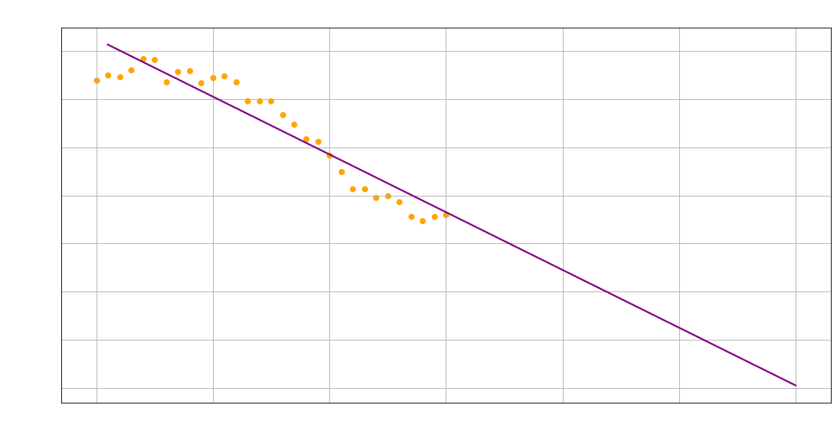
Advanced Analytics
- Intercept: 105,013.26943980425
- Slope: -2,399.63936663
- Linear Regression model
- Line of best fit to predict next
30 days

Slide 11
Conclusion
Air travel industry as a whole was negatively impacted.
The amount of passengers taking flights was almost cut in half throughout March 2020 (-45.15% change).
The average daily number of flights decreased by even more (-48.36% change).
Cargo flights actually increased during March 2020 (4.08% change).
Airlines and airports were negatively impacted, but at different rates depending on what the business depended on (cargo vs passengers).
Overall, air travel was negatively impacted by the pandemic in ways we have not seen before.

